Slide 1
South Carolina DOT Training Workshop Geophysics Field Testing Methods, Data Reduction, and Interpretation of Results
Robert C. Bachus and Glenn J. Rix
June 5 – 26, 2020

Slide 2
Downhole Method

Slide 3
Downhole Method
5 to 10 ft
Source
Δt₁
Shear and Compression
Waves
Triaxial
Receiver
Δt₂
$$V_{p,s}=\frac{∆z}{∆t_{2}−∆t_{1}}=\frac{∆z}{∆t_{interval}}$$
Δz

Slide 4
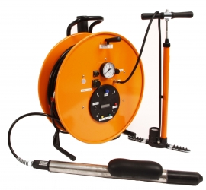
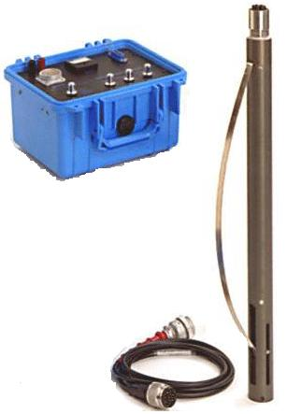
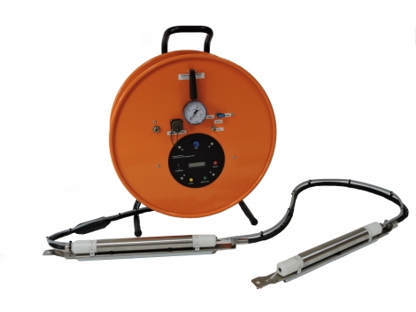
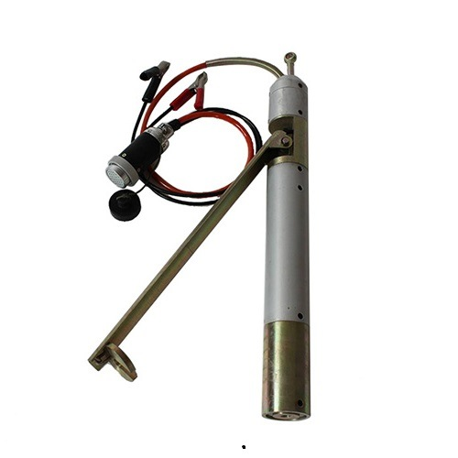
Downhole Method - Receivers

Slide 5
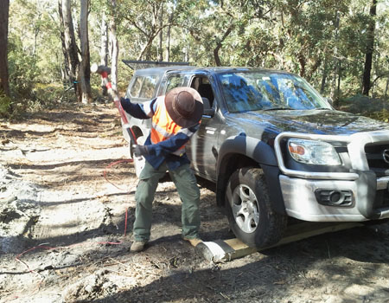
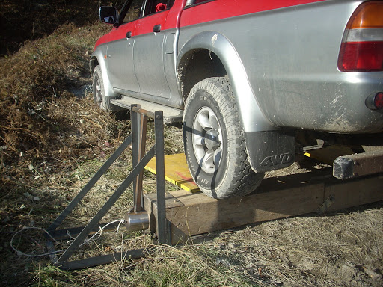
Downhole Method - Sources

Slide 6
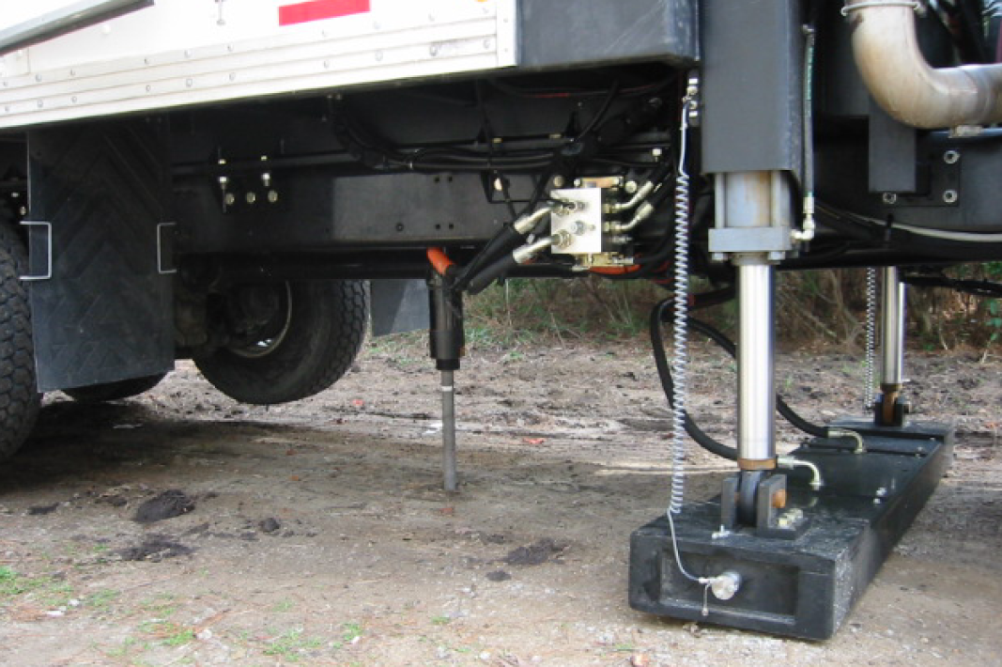
Seismic Cone

Slide 7
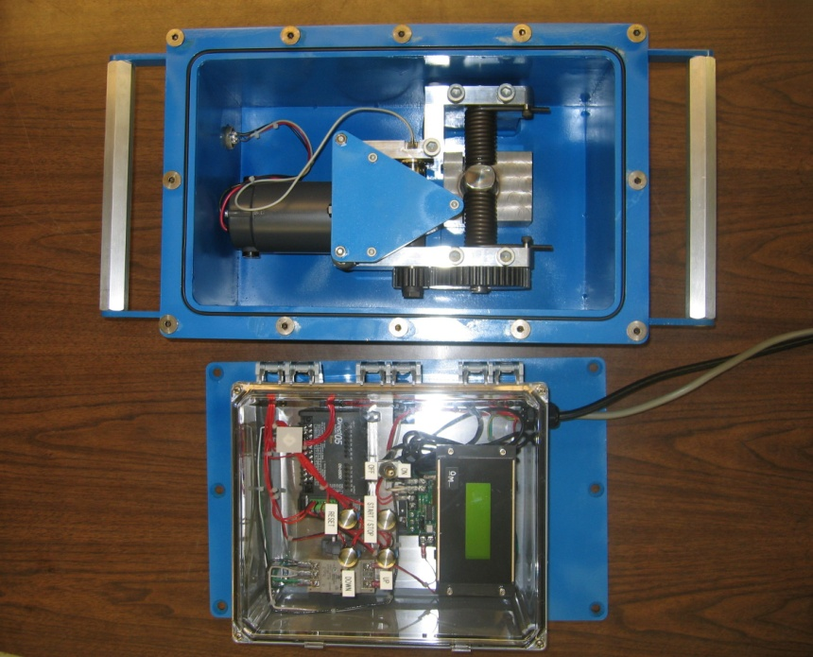
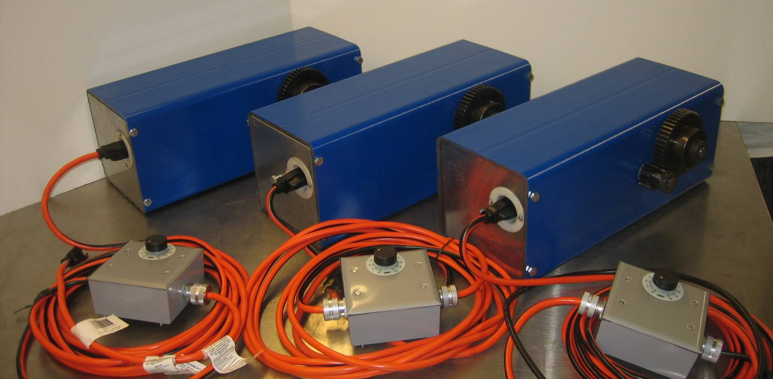
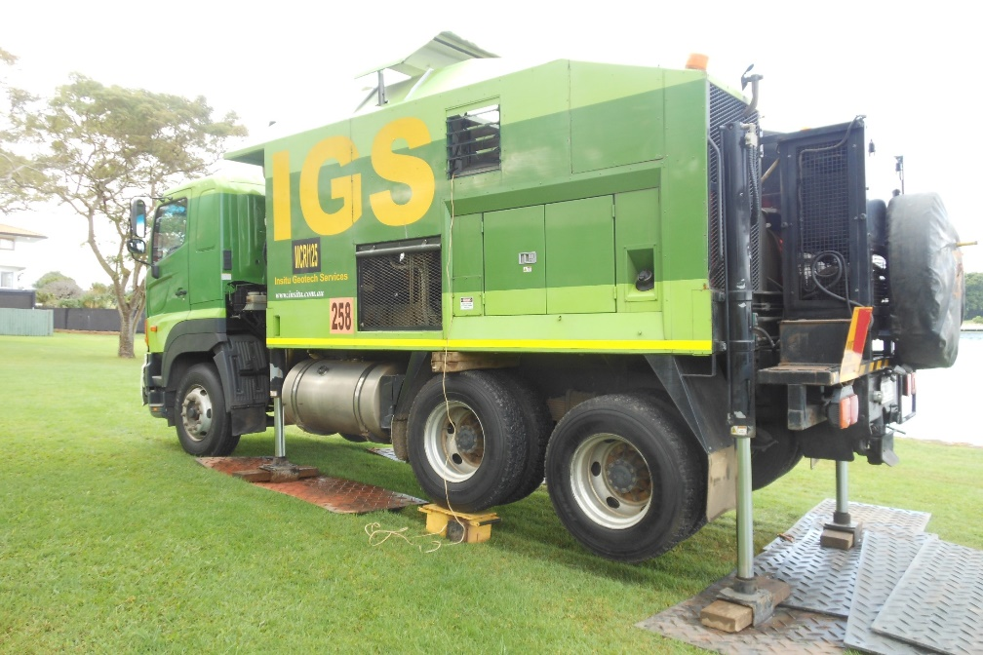
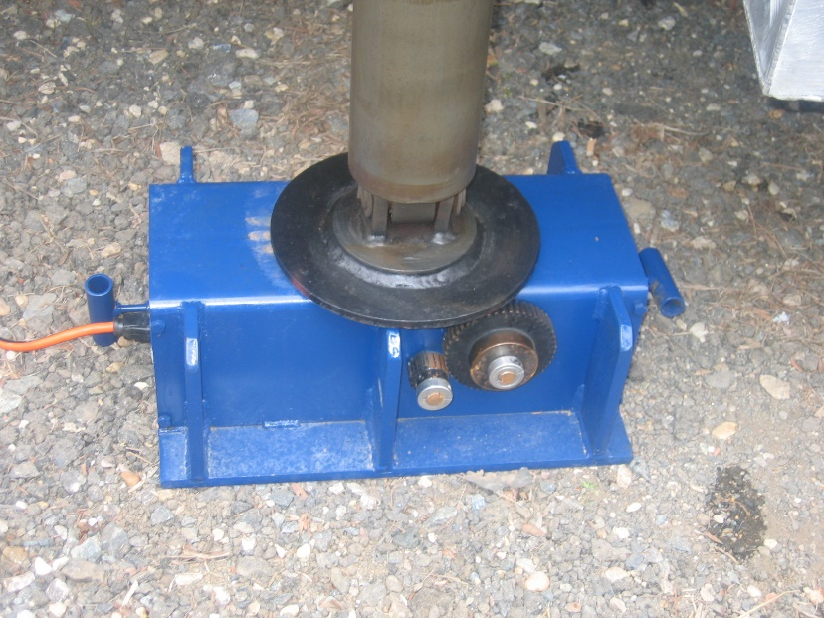
Georgia Tech AutoSeis
Courtesy of Paul Mayne

Slide 8
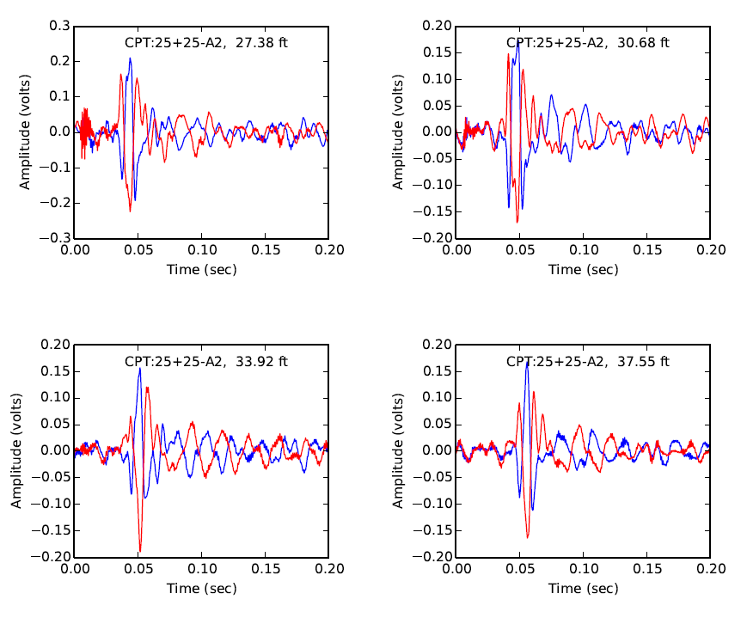
Downhole Data

Slide 9
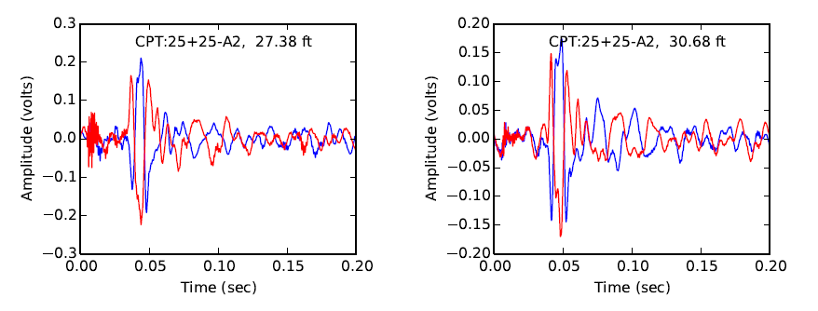
Downhole Data

Slide 10
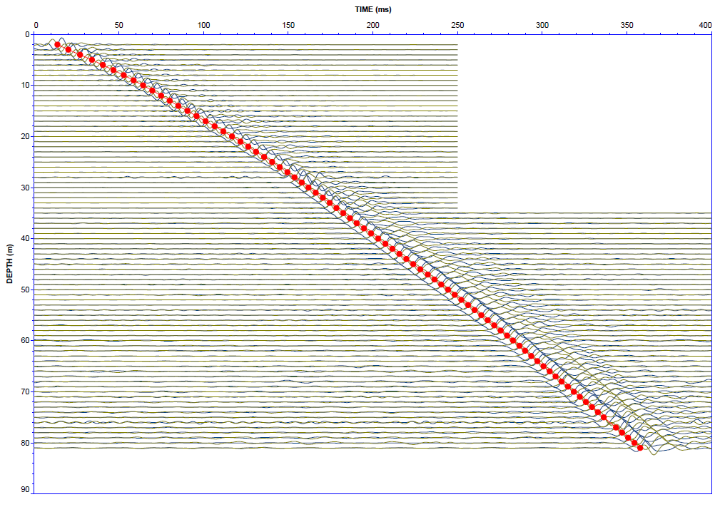
Downhole Data
Source: ConeTec

Slide 11
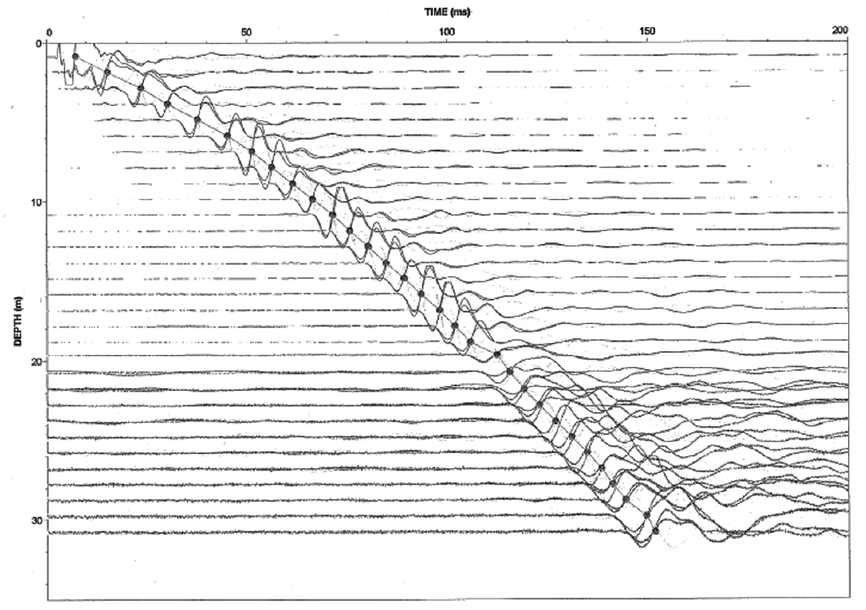
Downhole Data

Slide 12
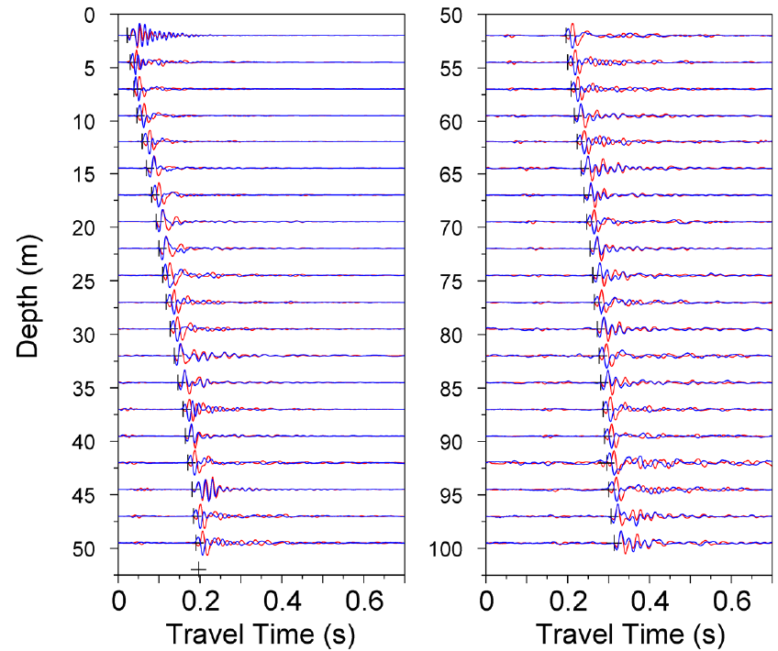
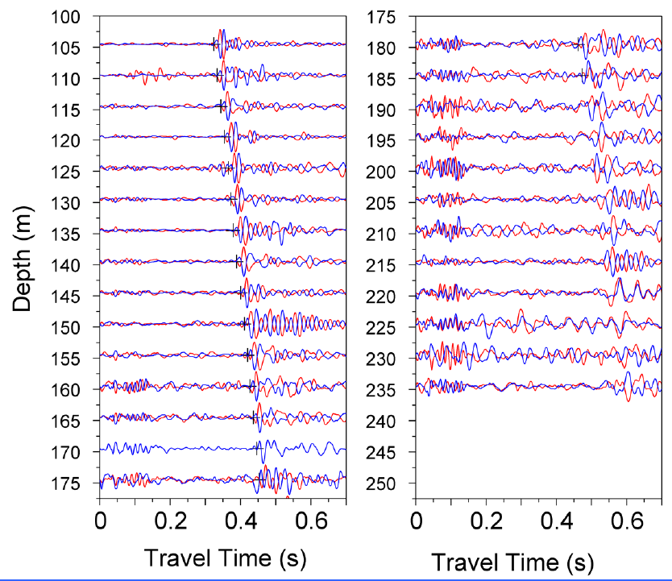
Downhole Data

Slide 13
Downhole Data
The contractor should always provide time history plots as part of their report as a QA/QC measure.

Slide 14
Downhole Data

Slide 15
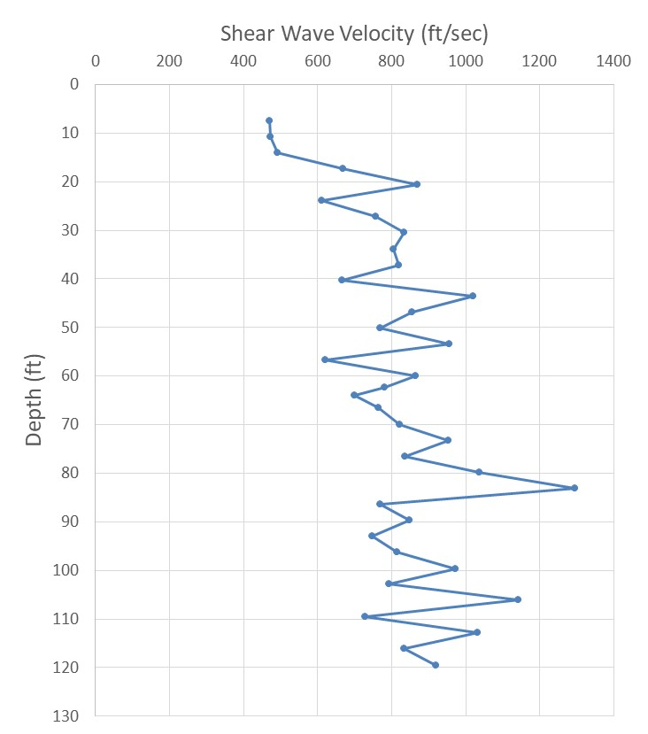
Downhole Data

Slide 16
Downhole Data

Slide 17
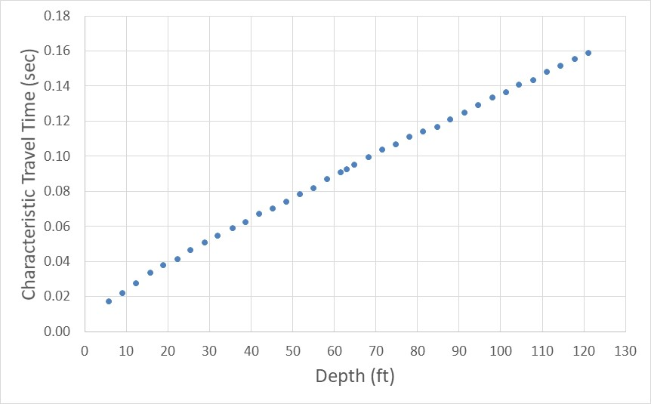
Downhole Data
$$V_{s}=\frac{52.6 \text{ft}}{0.066 \text{sec}}=795 \text{ft}\text{/}\text{sec}$$
0.066 sec
52.6 ft

Slide 18
Continuous Downhole
Courtesy of Paul Mayne

Slide 19
Downhole Method
Strengths
Simple concept and calculations
Readily implemented via the SCPTu
Limitations
Limited to depths of less than approximately 200 ft unless specialized equipment is used

